Slide 1

Recommendations for Best Software Engineering Practices at EOL
John Allison & Joe VanAndel
NCAR/EOL
Notes:
Please stop us at any time to ask questions!!

Slide 2
Acknowledgements
Members of the Software Engineering Guideline Committee:
Gary Granger
Tammy Weckwerth
John Allison
Linda Cully
Notes:
We are presenting the work of the committee.

Slide 3
Principles
Utility
Efficiency
Flexibility
Reliability
Accountability
Cooperation
Notes:
Motivation for improving our software development. Measure of effectiveness. Utility – provide a useful tool or product. Efficiency – make use of limited SE resources. Flexible – adapt s/w devel to evolving research, instruments, data, software tools and techniques.

Slide 4
Existing Practices(1)
Code Sprints
Source Control (Subversion, Git)
Issue Tracking (Bugzilla, Jira)
Memory checking (Valgrind)
Automatic Builds
SCons for scalable, modular builds
Notes:
These practices are not universal in EOL, but are reasonably common.

Slide 5
Code Sprints
Small group works together for several days
Significant Effort to Prepare for a Sprint
Large benefits from
working collaboratively
being removed from distractions
Test Suites are invaluable

Slide 6
Source Code Control
Need to track changes, be able to back out mistakes
EOL uses Subversion and Git
Git
Works well for collaboration with multiple groups
Supports Revision Control while in field
Notes:
Source code control does not mean creating sporadic copies of the source code, and hiding the floppy/CD in your desk!
EOL uses Git for joint development with Colorado State’s CHILL radar group

Slide 7
Issue Tracking
Very useful
Challenging to convince end-users to enter issues

Slide 8
Memory Checking
Commercial tools are good, but expensive
EOL uses valgrind: (valgrind.org)
Valgrind is invaluable for detecting:
Memory leaks
Using memory after it has been freed
Referencing uninitialized memory
Allows you to suppress complaints about existing libraries
Notes:
Greatly increases reliability of software.

Slide 9
Automated Builds
Continuously checkout, build software projects
Detect problems with checkins.
Particularly useful for projects with automatic tests
Notes:
Greatly increases reliability of software.

Slide 10
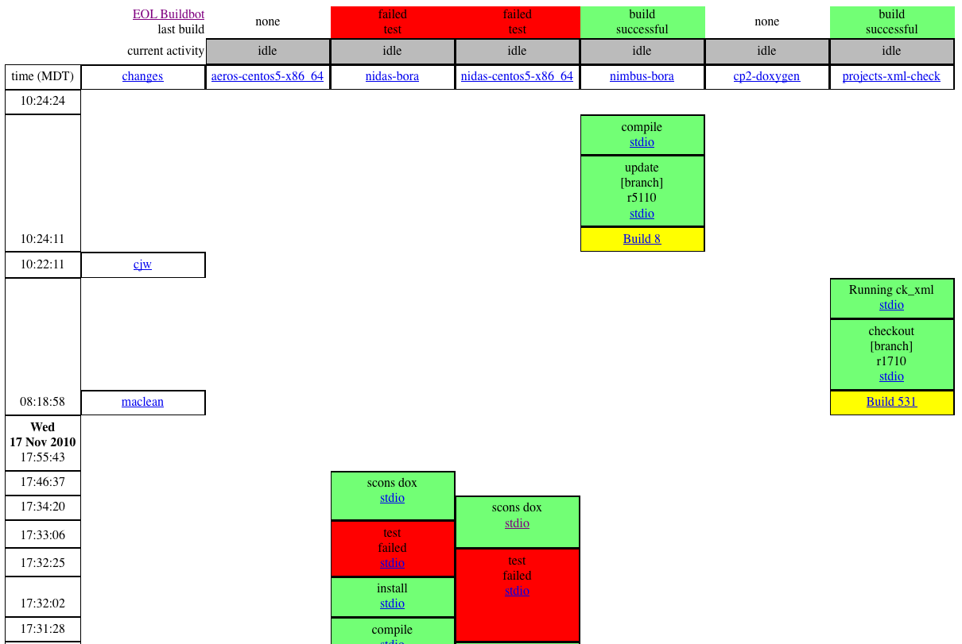
Automated Builds
Notes:
Screen shot of web page: who changed the source, what’s the state of each build.

Slide 11
SCons (scons.org)
Superior alternative to Make
Scales better for large projects
Auto dependency tracking
Written, extended with Python
Notes:
EOL still uses a number of build systems, but a significant number of projects are using SCons

Slide 12
Existing Practices (2)
Coding Practices
Separate interface from implementation
Write, use reusable libraries
Use open source packages: Boost, Qt, DDS, ACE
Document with Doxygen
Notes:
Doxygen uses comments in your source code to produce documentation of your software.

Slide 13
Future directions
Formalization
Software development guidelines document
Project management
Process priming
Techniques

Slide 14
Guidelines document
Motivated from CDS retreat
Desired to further improve our process, nurture skills, and (continue to) produce quality software
Management directive
In progress
Currently more descriptive than prescriptive
Needs prioritization or levels of requirements
Encourage use by non-SE's
http://www.eol.ucar.edu/data/software/guidelines
Notes:
Led by Gary Granger
Document still has almost as many questions as answers

Slide 15
Software development guidelines
Purpose – principles
Project management – agile, tracking, sprints
Development process – requirements, documentation, design & code reviews
Notes:
Condensed outline of the current document

Slide 16
Software development guidelines (2)
Coding guidelines – revision control, testing, automated builds, logging
Tools and technologies
Staying informed
Process review
Notes:
Condensed outline of the current document

Slide 17
Project management
Prefer agile practices
Project management specialist
Other kinds of sprints
Requirements gathering
High-level design
Process decisions
Review/document development process choices
Process priming / enculturation
Notes:
Specialist in Field Project Services group is Sandra Thurn, working with various projects including software
We encourage developers to consult the expert(s)
Even if we’re not strictly following an agile methodology like SCRUM, we want to somewhat formalize our development choices, documentation, and... take advantage of what makes sense
Process decisions: explicitly review and document what process methods a project is using – which menu items from the guidelines – more or less / formal or informal based on particular project needs – people, finances, scale/scope

Slide 18
Process priming
New hires
write production code the first day
with a mentor
following our development guidelines / best practices
immediate process & culture immersion
Old hands on new projects
Same mentoring as a new hire, or
Initial pair programming to mutually reinforce
best-practices
Notes:
“production code” may not actually mean pushing to the world, depending on project, and may not actually be code but some other task, depending on person, but we want to start with a real task on a real project and provide an immediate accomplishment and positive reinforcement
Includes student assistants, software engineers, associate scientists– whoever is joining the project.
“Do as I say, not (necessarily) as I have done in the past” – also reinvigorates proper practices in the mentor
This process feeds back to the guidelines report – what the mentor actually teaches informs the priorities of the guidelines
Getting everyone on same page
This happens already to some degree, but perhaps the process should be formalized, or at least more widespread, with “the first day” emphasized

Slide 19
Techniques
Pair programming
Share programming
Cross-group development
Test-first or test-driven design
Use cases or user stories
Design, requirements, and code reviews
Notes:
Here a few more ideas for specific techniques not already covered.
We have done a little pair programming in the past- traditional simultaneouswork with one driver (typer) and one observer (reviewer). Was helpful to learn a new technology and to cross-fertilize knowledge
Share programming is an idea to split in half smaller projects that are traditionally developed by one programmer. The project gets two half-time programmers that co-operate but not necessarily pair-program. Could help with single point of failure issues; adds some level of review.
Cross-group development means having programmers work for/with different groups/projects than their “home” group within EOL. We can tend to get specialized in EOL (and perhaps UCAR as a whole?). It has been done to a limited degree and helped bring new perspectives and ideas to each side. We would consider crossing lab boundaries also.
While testing is an established part of our process, for some upcoming developments we are considering making it more prominent by going test-first (write a failing test then code to fix it).
We have done use cases at times, but not fully as the requirements motivator
Reviews: we’ve done some ad hoc reviews but are trying to be more explicit and collaborative, even if still informal.

Slide 20
Discussion
Questions?
What are you doing?
How formal is your process?
Enforcement or encouragement?
How to entrain non-SE's (scientists, techs, etc)?
SE mentors?
Notes:
Enforcement:
in performance reviews?
peer pressure or culture-based?
Entraining non-SE's: we do have a scientist rep on the guidelines document task force

Slide 21
Thank you for coming!
John Allison: jja@ucar.edu
Joe VanAndel : vanandel@ucar.edu
NCAR is supported by the National Science Foundation.

